Slide 1
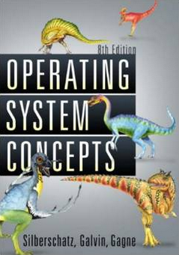
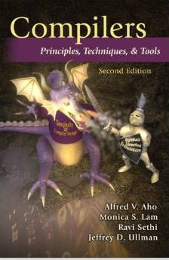

Intro. To Quality Software - Fight the Complexity of SW
Moonzoo Kim
School of Computing. KAIST

Slide 2
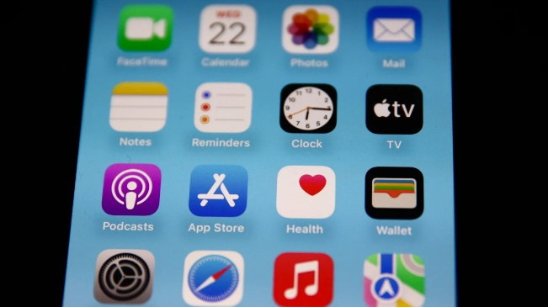
What is Software?
https://mashable.com/article/how-to-hide-apps-iphone
Computer programs (instructions) that provide desired features and functionality
Associated documentation that describes the operations and use of the programs
[PrMa20 ]

Slide 3
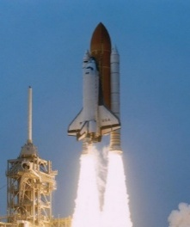


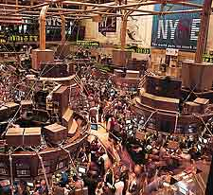
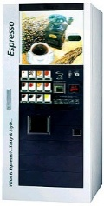
Where is Software?
Everywhere!
Types of Software
System software
Embedded software
Application software
Engineering/scientific software
Product-line software
Cloud/Web/Mobile software
AI software (robotics, neural nets, game playing)
[PrMa20 ]

Slide 4
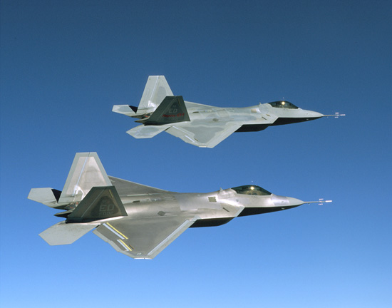
Role of S/W: Increased in Everywhere
F-35 (20 MLoC)
2020년
자료출처: Watts Humphrey 2002

Slide 5
Analogy of SE with Civil Engineering
There are various kinds of
construction from a house
to a building complex

Slide 6
Analogy with Civil Engineering(Cont.)
When building a small house,...
With simple tools
From just a blueprint
By small group of
novice workers
Some failures
are endurable

Slide 7
Analogy with Civil Engineering(Cont.)
When constructing a building complex,...
we must re-think everything

Slide 8
Analogy with Civil Engineering(Cont.)
With scalable tools
as well as simple ones
Use different
materials

Slide 9
Analogy with Civil Engineering(Cont.)
By a big group of various technicians
With collaborations
and guides
Set of blueprints
As well as careful plans

Slide 10

Software Development Cycle
A practical end-to-end formal framework for software development
A SW Development Framework for SW with High Assurance
Requirement
analysis
System
design
Design
analysis
Implement-
ation
Testing
Monitoring
Formal
require-
ment
Spec.
Formal
system
modeling
Model
analysis/
verification
Model-
assisted
code
generation
Model-
based
testing
Runtime
monitoring
and
checking

Slide 11
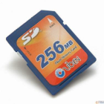



Related Disciplines to SW Development
Undergraduate CS classes contributing to SW development
Discrete math
Algorithm
PL
Automata
OS
System programming
Cyber physical system
Intro. to SE
SW Development
Embedded
Systems
System
Engineering
Programming
Languages
Algorithms
OK
System
modeling
System
spec.
Automated Testing & Debugging
or
Requirement
properties
Req.
spec.
Logic
(Φ Ω)
Counter
example(s)

Slide 12
Hardware v.s. Software
Flexibility leads to low development cost
Minimal costs for HW board manufacturing > 20K$
Minimal costs for SW development = 0$
Growing popularity leads to large and complex software systems
Intel Meteor Lake CPU : 25 billion transistors
Windows 11: 70 million LoC (= multi-billions machine instructions)
Much harder to validate/verify (V&V) software
HW design exploits symmetry, structure, and components
Formal design and V&V tools (e.g. Verilog, VHDL, etc) are popular
Standard property spec. language: OVL, PSL, SVA, etc
SW design allows maximal degree of freedom in programs
Formal principles and techniques have been rarely applied to SW due to
Failure to manage (entire) SW complexity
Lack of commercial tools and supports
(relatively) High learning curve
Products of all engineering fields provide warranty except SW
Ex> Intel CPU provides 3 years warranty
Ex> Microsoft Windows® provides no warranty - Use it at your own risk!!!
Notes:
Smallest hw board manufacturins cost: $20k
Ex. Boing is not anymore airplane company, but SW company. Costs of SW development overwhelm the whole airplane development
I interviewed Samsung D-TV 4 years ago. Boss said he was able to develop HW but does not understand SW
SW is double-sharpened razor -> use as you want at your own risk!!!
After 6 months’s training, people think he is a programmer. Not in EE, ME, and any other fields!!!

Slide 13
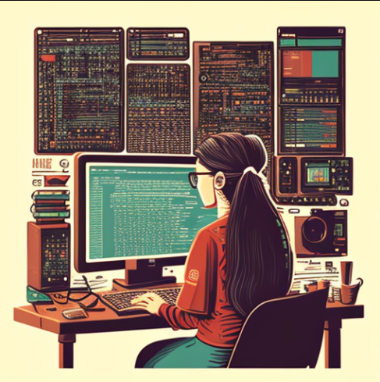
Software Engineering?
“The application of a systematic, disciplined, quantifiable approach to development, operation and maintenance of software” (IEEE Systems and Software Engineering Vocabulary, 2010)
“a systematic engineering approach to software development” (Wikipedia, https://en.wikipedia.org/wiki/Software_engineering)
From Prof. Shin Yoo’s CS350 lectures

Slide 14
Software Crisis
As long as there were no machines, programming was no problem at all; when we had a few weak computers, programming became a mild problem, and now we have gigantic computers, programming has become an equally gigantic problem. — Edsger Dijkstra, The Humble Programmer, Communications of the ACM, 1972
From Prof. Shin Yoo’s CS350 lectures

Slide 15
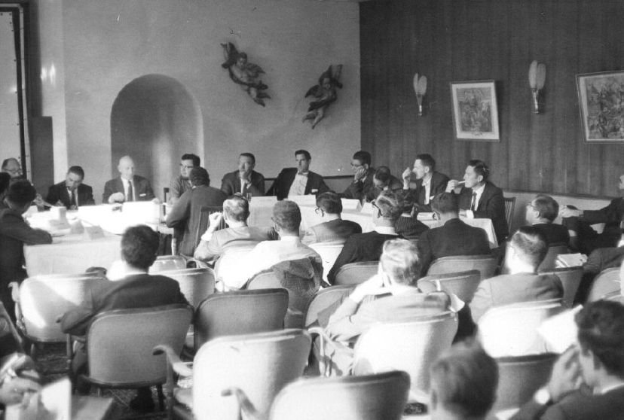
NATO Conference 1968
(Dijkstra was also there)
The phrase ‘software engineering’ was deliberately chosen as being provocative, in implying the need for software manufacture to be based on the types of theoretical foundations and practical disciplines that are traditional in the established branches of engineering. - Editors of the proceedings of Software Engineering (1968)
From Prof. Shin Yoo’s CS350 lectures

Slide 16
NATO Conference 1968
(Dijkstra was also there)
The conference proceedings is a fascinating read: you can actually read the whole thing in a nicely typeset PDF: https://www.scrummanager.com/files/nato1968e.pdf
There is also a very helpful blog post by Logan Mortimer, a software engineer in Melbourne: https://isthisit.nz/posts/2022/1968-nato-software-engineering-conference/
Many interesting ideas and questions. Are software to be “manufactured” like other engineering products? How do we measure progress? How do we scale up to hundreds and thousands of people building the same system together?
From Prof. Shin Yoo’s CS350 lectures

Slide 17
How is SW like other engineering product?
How is it different from other engineering products?
From Prof. Shin Yoo’s CS350 lectures

Slide 18
Essential Properties of SW
as pointed out by Brooks Jr. in 1987
Complexity
More complex than any other human constructs for their size (no two parts are identical, because we would factor them out)
Scaling up does not mean making the same thing larger
Conformity
Physicists firmly believe that there is a unified theory of things
Most of complexity in SW is arbitrary - SW has to conform to countless many things (institutions, systems, users, regulations…)
From Prof. Shin Yoo’s CS350 lectures

Slide 19
Essential Properties of SW
as pointed out by Brooks Jr. in 1987
Changeability
Compared to other engineering products, SW is more frequently pressured to change
If a software system is useful, people will try new edge cases at the borderline of the original domain
A successful software can outlive the underlying hardware, and therefore has to adapt
Invisibility
SW cannot be easily embedded in space and therefore has no useful geometric representation
Without visual representation, communication and design becomes much more difficult
From Prof. Shin Yoo’s CS350 lectures

Slide 20

“No Silver Bullet”
“Of all the monsters that fill the nightmares of our folklore, none terrify more than werewolves, because they transform unexpectedly from the familiar into horrors. (…) (software) is usually innocent and straightforward, but is capable of becoming a monster of missed schedules, blown budgets, and flawed products.” - Brooks Jr.
From Prof. Shin Yoo’s CS350 lectures

Slide 21
“No Silver Bullet”
Brooks Jr. argues that there is no silver bullet that will kill the SW werewolf: the difficulties are inherent in SW, and no single technique will solve all of these.
In the same titled essay, Brooks Jr. examines some candidates for the silver bullet (back in 1987)
From Prof. Shin Yoo’s CS350 lectures

Slide 22
Summary
SW is the most complex engineering artifact
Building SW well requires more than excellent programming skills (although it helps).
We will think about known problems, and get ourselves familiarized with widely accepted responses to those problems through lectures and team projects

Slide 23
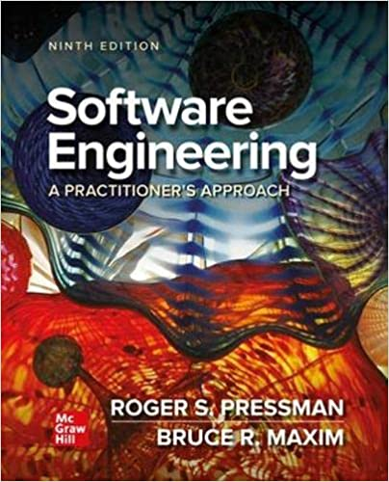
Textbook
[PrMa20] Roger S. Pressman, and Bruce R. Maxim,
Software Engineering – A Practitioner’s Approach,
9th Ed., Mc Graw Hill, 2020 (ISBN-13: 978-1259872976, Available Online)

Slide 24
Course Logistics (1/2)
Pre-requisite:
CS.20300 System Programming, CS.20200 Programming Principles
I do not recommend students in non-SoC majors to take this class for its heavy class workload (HW, team project, a large amount of documentation, etc.).
Also, freshmen students (whose student IDs are 2025xxxx) are not eligible to take this 3rd year class
team projects requires technical communication skills

Slide 25
Course Logistics (2/2)
Team projects:
You should make a team consisting of 4 students by yourselves and report your team members by Oct 1st.
No team change allowed w/o legitimate reasons after Oct 1st (e.g., all teammates except you apply leave of absence, etc.)
All teams will work on the same project topic (TBD) to learn and discuss with other teams
You should present your team’s project progress regularly at the class to promote lively discussion and feedback
At the end of semester, you will evaluate your teammates and that evaluation contributes to grades of your teammates (e.g., to respect those who work hard and to reduce “free-rider”)

